Slide 1
Poetry

Slide 2
What do you think about when you hear the word Poetry?

Slide 3
Poetry is...
- from the heart, the truth
-can be emotional
-has different messages
-has many forms and styles
-is not always boring
-can be fun

Slide 4
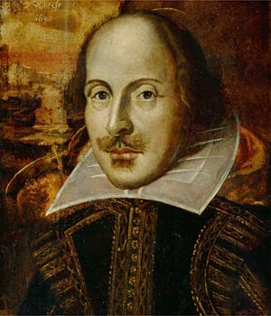
Types of Poetry...
-Haiku
-Limerick
-Couplet
-Rhymes
-Free Verse
-Imagery
-Lyric
William Shakespeare

Slide 5
Haiku
5 May this day be filled
7 With wonder and surprises.
5 But only good ones.
-made up of three lines that DO NOT rhyme
-5,7,5 syllable pattern

Slide 6
Limerick
9 There was a young lady from Leeds
8 Who swallowed a package of seeds.
6 Now this sorry young lass
6 Is quite covered in grass,
9 But has all the tomatoes she needs
-short and funny
-5 lines
-lines A, B and E rhyme with 7 to 10 syllables
-lines C and D rhyme with 5 to 7 syllables

Slide 7
Couplet
It doesn't take much, but more than a little,
to reach out and solve sin's riddle.
The sadness and pain that blankets this Earth,
will Never be as strong as Jesus' Birth.
God, we know that we're Never Alone,
so let us be Filled, your Holy Spirit in our every bone.
You are the Faith and Hope and Love,
and let us share it, straight from Above.
-usually 14 lines
-can be all couplets
-in sonnet last two lines important and rhyme
-seen in Shakespeare

Slide 8
Rhymes
Mary, Mary quite contrary,
How does your garden grow?
With silver bells and cockle shells
And pretty maids all in a row.
-rhyming pattern
-more free in style
-all words can rhyme or alternate lines can rhyme
-usually small paragraphs
-can be long or short

Slide 9
Free Verse
After the Sea-Ship—after the whistling winds;
After the white-gray sails, taut to their spars and ropes,
Below, a myriad, myriad waves, hastening, lifting up their necks,
Tending in ceaseless flow toward the track of the ship.
no metrical pattern
can rhyme but does not have to
open for creativity

Slide 10
Imagery
A host, of golden daffodils;
Beside the lake, beneath the trees,
Fluttering and dancing in the breeze.
Continuous as the stars that shine
And twinkle on the Milky Way
-brings reader into poem
-uses descriptions and emotions to create a picture in the reader’s mind

Slide 11
Lyric
B.E.P. Where is the Love?
Madness is what you demonstrate
And that's exactly how anger works and operates
Man, you gotta have love just to set it straight
Take control of your mind and meditate
Let your soul gravitate to the love, y'all, y'all
People killin', people dyin'
Children hurt and you hear them cryin'
Can you practice what you preach
And would you turn the other cheek
Father, Father, Father help us
Send some guidance from above
Cause people got me, got me questionin'
Where is the love (Love)
-in the form of a song
-usually done with music
-in Shakespeare Lyric refers to Odes and Sonnets

